Slide 1


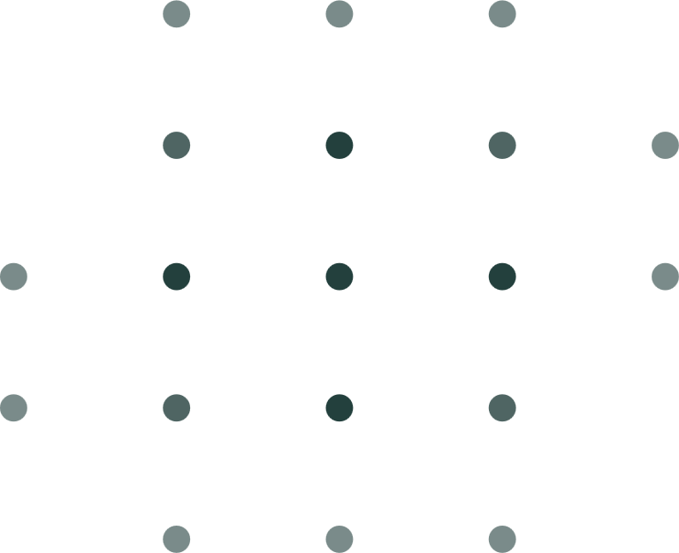



Milestone #1 Progress Report
https://yanarex.github.io/shuttle-app-website/
Members: Joseph Hilte, Tony Arrington, Jonathan Suo, and Chase Monigle

Slide 2



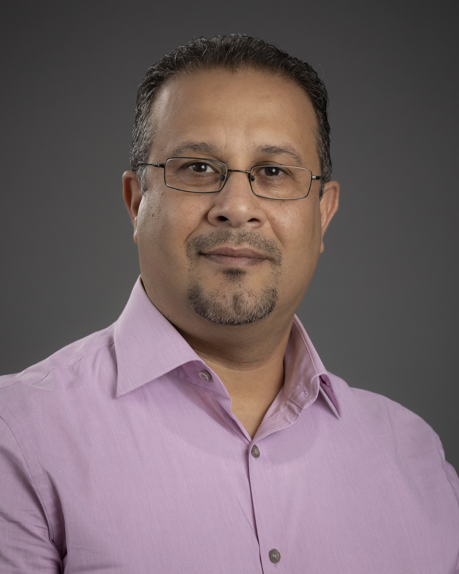





Who is involved?
Faculty Advisor: Professor Khaled Ali Slhoub
Client #1: Student Vincent Borrelli
Client #2: TBD (Working with Shuttle Services)

Slide 3

Technical/Collaboration Tools
Main Technical Tool: Android Studio
Collaboration Tools:
Github
Google Calendar
Google Drive
Discord

Slide 4
Requirements, Design, and Test Plan Documents
Main Features/Outlined.
GUI Mockups
UML/Class Diagrams
Created Test Cases/Testing Methods

Slide 5

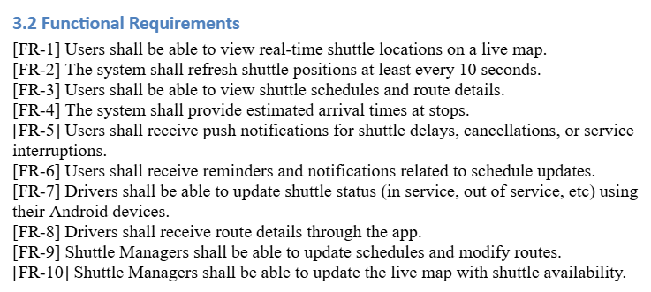


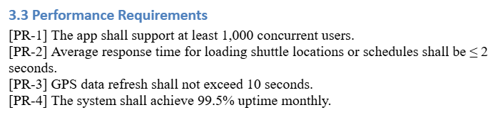
Requirements Examples
Milestone 1
Milestone 3

Slide 6
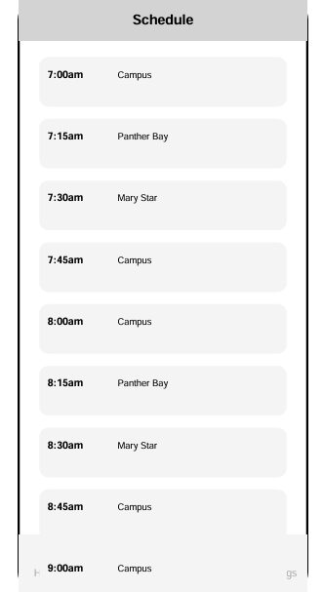
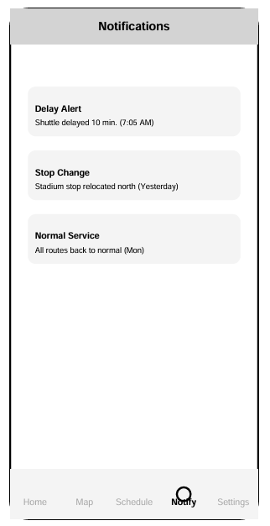
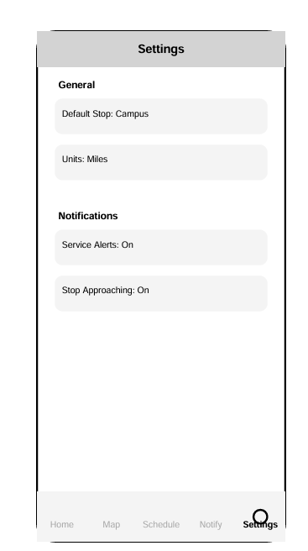
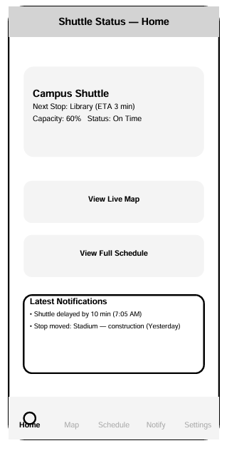
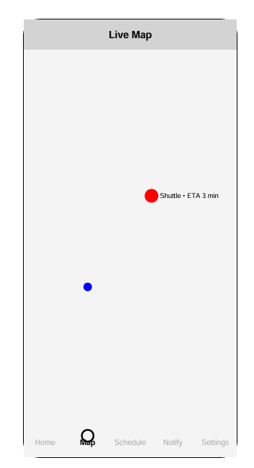
Design Mockups
Milestone 1
Milestone 3

Slide 7
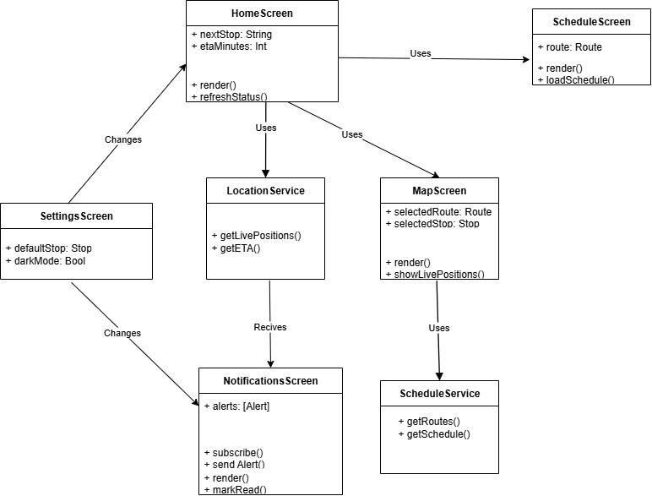
UML Diagram
Milestone 1
Milestone 3

Slide 8
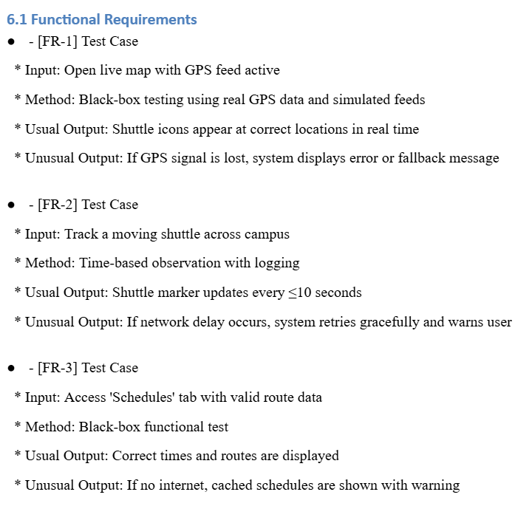
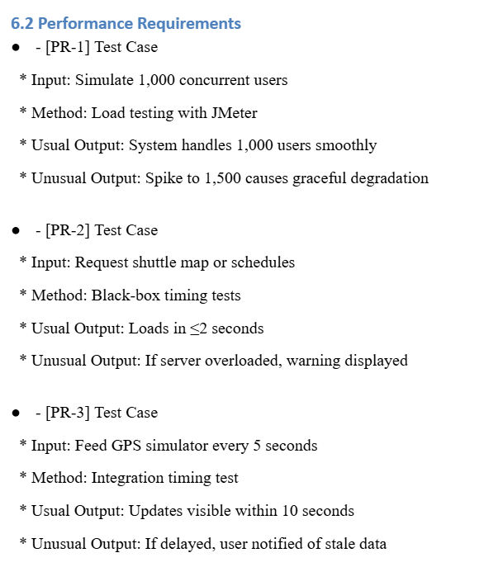
Test Plan Examples
Milestone 1
Milestone 3

Slide 9
Challenges
Learning Curve
Tracking
Shuttle Services
Milestone 1
Milestone 3

Slide 10

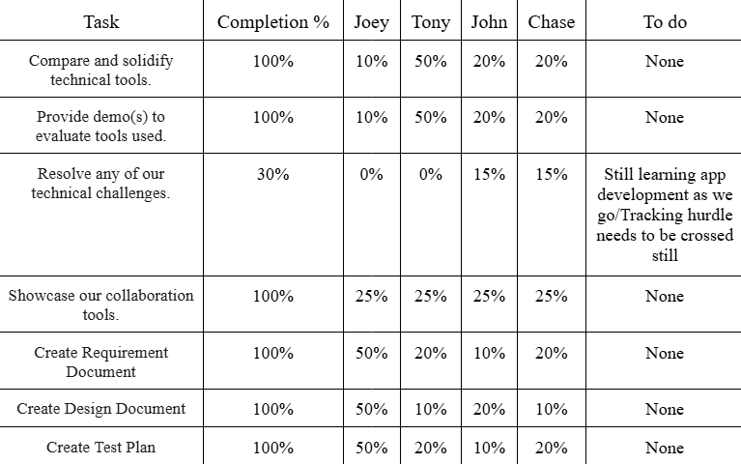
Milestone #1 Progress

Slide 11
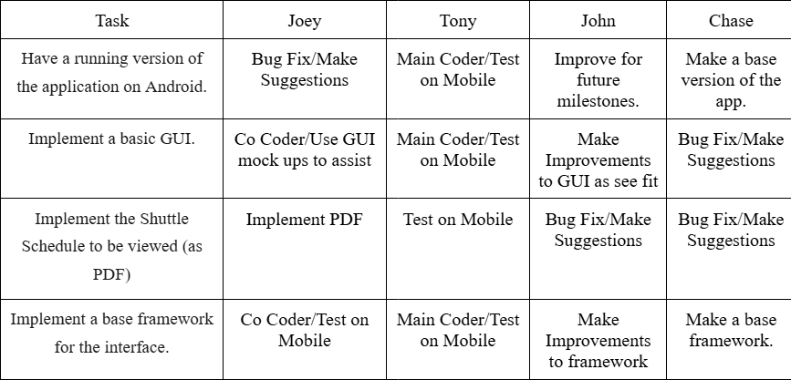
Milestone #2 Plan

Slide 12






QUESTIONS?
Visit our website
https://yanarex.github.io/shuttle-app/

